Slide 1
CSE 545 Heap: Fastbin Double Free
Tiffany Bao tbao@asu.edu
Notes:
https://sourceware.org/glibc/wiki/MallocInternals
https://sploitfun.wordpress.com/2015/02/10/understanding-glibc-malloc/
https://www.bencode.net/posts/2019-10-19-heap-overflow/
https://azeria-labs.com/heap-exploitation-part-2-glibc-heap-free-bins/

Slide 2
Announcement
Assignment 3 is released, ddl: 4/30
Final: All previous challenges combined,
28 challenges, 112 points in total
Due: 5/7

Slide 3
Final Score
Assignment 1-3: 85%, every assignment accounts for 85% / 3 = 28.33%
e.g., Assignment 1: 11 / 10 * 28.33
Final: 15%
Participation: 10%
Track: TO BE RELEASED

Slide 4
Fastbin double Free

Slide 5
Tcache Bin
metadata
metadata
data
data
fd pointer
fd pointer

Slide 6
Tcache Bin
metadata
metadata
data
data
fd pointer
fd pointer
Fast Bin
metadata
metadata
metadata
data
data
data
fd pointer
fd pointer
fd pointer

Slide 7
Tcache Bin
metadata
metadata
…
…
data
data
00000
fd pointer
fd pointer
Fast Bin
metadata
metadata
metadata
data
data
data
fd pointer
fd pointer
fd pointer

Slide 8
Tcache Bin
1
Empty tcache bins
metadata
metadata
…
…
data
data
00000
fd pointer
fd pointer
Fast Bin
metadata
metadata
metadata
data
data
data
fd pointer
fd pointer
fd pointer

Slide 9
Tcache Bin
1
Empty tcache bins
Fast Bin
metadata
metadata
metadata
data
data
data
fd pointer
fd pointer
fd pointer

Slide 10
Tcache Bin
2
malloc()
Fast Bin
metadata
metadata
metadata
data
data
data
fd pointer
fd pointer
fd pointer

Slide 11
Tcache Bin
2
malloc()
Fast Bin
metadata
metadata
metadata
data
data
data
fd pointer
fd pointer
fd pointer

Slide 12
Tcache Bin
2
malloc()
Fast Bin
metadata
metadata
data
data
fd pointer
fd pointer

Slide 13
Tcache Bin
2
malloc()
metadata
data
00000000
Fast Bin
metadata
data
fd pointer

Slide 14
Tcache Bin
2
malloc()
metadata
data
00000000
Fast Bin
metadata
metadata
data
fd pointer
data
00000000

Slide 15
Tcache Bin
2
malloc()
metadata
metadata
data
fd pointer
data
00000000
Fast Bin
metadata
data
00000000

Slide 16
metadata
Tcache Bin
2
malloc()
data
fd pointer
metadata
metadata
metadata
data
data
fd pointer
data
fd pointer
fd pointer
Fast Bin

Slide 17
Tcache Bin
3
Edit the chunk from Step 2
metadata
data
fd pointer
metadata
metadata
metadata
data
data
fd pointer
data
fd pointer
fd pointer
metadata
victim
Fake Chunk

Slide 18
Tcache Bin
4
malloc() x 3
metadata
metadata
metadata
data
data
fd pointer
data
fd pointer
fd pointer
metadata
victim
Fake Chunk

Slide 19
Heap is fun!
Service IP: 107.21.135.41 Port: 16666
Service file:
https://cse545.tiffanybao.com/labs/week16/double_free.c
https://cse545.tiffanybao.com/labs/week16/double_free
https://cse545.tiffanybao.com/labs/week16/libc.so.6
https://cse545.tiffanybao.com/labs/week16/ld-2.27.so

Slide 20
How to debug

Slide 21
Leak Libc Base Address

Slide 22
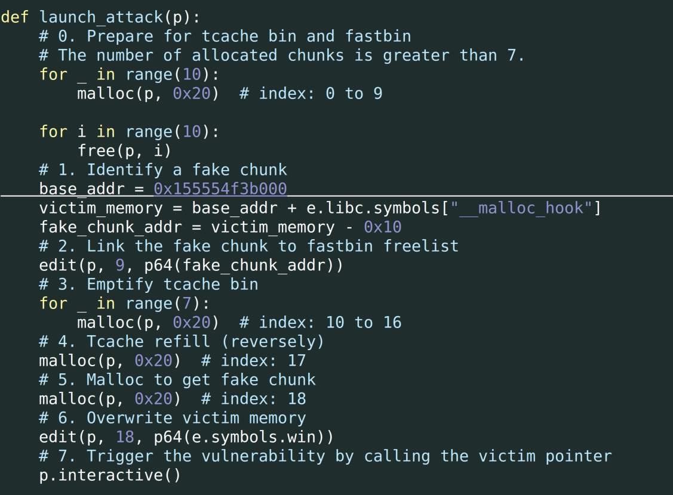

Slide 23
Approach 1: find a fake chunk with libc info
Find a memory location that satisfy the necessary condition for a fake chunk
The libc information is contained in the fake chunk
e.g., 0x602248

Slide 24
Fast Bin
metadata
metadata
metadata
data
data
data
fd pointer
fd pointer
000000
1
2
0x602248
metadata
libc-related
address
Fake Chunk

Slide 25
Tcache Bin
3
malloc() x 7
metadata
metadata
…
…
data
data
00000
fd pointer
fd pointer
Fast Bin
metadata
0x602248
metadata
metadata
victim
data
data
00000000
fd pointer
fd pointer

Slide 26
Tcache Bin
3
malloc() x 7
Fast Bin
0x602248
metadata
metadata
metadata
victim
data
data
00000000
fd pointer
fd pointer

Slide 27
Tcache Bin
4
malloc()
Fast Bin
0x602248
metadata
metadata
metadata
victim
data
data
00000000
fd pointer
fd pointer

Slide 28
Tcache Bin
4
malloc()
0x602248
metadata
metadata
victim
00000000
fd pointer
data
Fast Bin

Slide 29
Disadvantage
Finding a fake chunk like such may not be easy
The address of fake chunk may also change
E.g., PIE and ASLR

Slide 30
Approach 2: unsorted bins
siz0x20
arena -> bins
FD
BK
-> Forward
<- Backward
chunk
chunk
…

Slide 31
Unsorted Bin with one chunk
-> Forward
metadata
metadata
data
fd pointer
bw pointer
fd pointer
bw pointer
main_arena @ glibc

