Slide 1
CSE 545 basic Software Vulnerabilities
Tiffany Bao tbao@asu.edu

Slide 2
BEFORE the lab:
Please install gdb in your Linux environment.
e.g., sudo apt install gdb

Slide 3
Last Week’s Lab
service_vuln.c

Slide 4
Agenda
Command Line Injection
Directory Traversal
Stack Overflow
x86_64 Assembly 101
C Debugging

Slide 5
Command Line Injection

Slide 6
Example
void check(char id[15]){
char command[50] = {};
sprintf(command, "cat records/%s", id);
system(command);
}

Slide 7
Example
void check(char id[15]){
char command[50] = {};
sprintf(command, "cat records/%s", id);
system(command);
}

Slide 8
Example
id: “tiffanyb”
void check(char id[15]){
char command[50] = {};
sprintf(command, "cat records/%s", id);
system(command); ”cat records/tiffanyb”
}

Slide 9
Example
id: “tiffanyb; cat secret”
void check(char id[15]){
char command[50] = {};
sprintf(command, "cat records/%s", id);
system(command); ”cat records/tiffanyb; cat secret”
}

Slide 10
DEMO

Slide 11
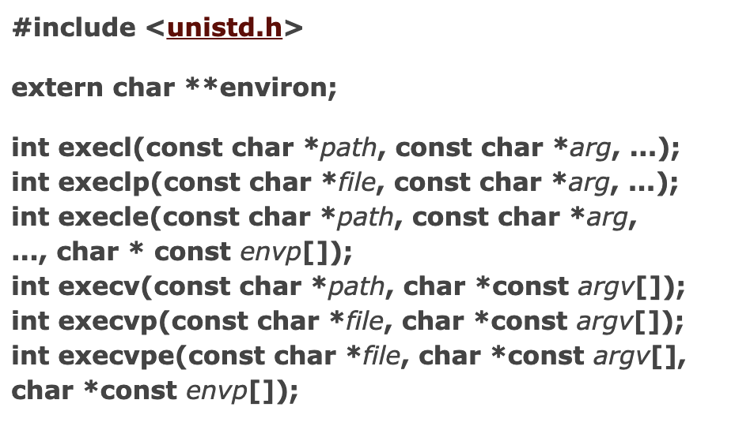
DEFENSE
Avoid using system
Use the exec family
execl(“/bin/ls”, “/bin/ls”, “-l”, “/home/ctf”, NULL);
https://man7.org/linux/man-pages/man3/exec.3.html

Slide 12
Defense
Vulnerable to command line injection
Immune to command line injection
void check(char id[15]){
char command[50] = {};
sprintf(command,
"cat records/%s", id);
system(command);
}
void check(char id[15]){
char path[50] = {};
sprintf(path, "records/%s", id);
execl(”/bin/cat”,”/bin/cat",
path, NULL);
}

Slide 13
Is the code secure now?

Slide 14
directory traversal

Slide 15
Defense
Vulnerable to command line injection
Immune to command line injection
void check(char id[15]){
char command[50] = {};
sprintf(command,
"cat records/%s", id);
system(command);
}
void check(char id[15]){
char path[50] = {};
sprintf(path, "records/%s", id);
execl(”/bin/cat”,”/bin/cat",
path, (char*) NULL);
}

Slide 16
Example
void check(char id[15]){
char path[50] = {};
sprintf(path, "records/%s", id);
execl("/bin/cat", "/bin/cat", path, NULL);
}

Slide 17
Example
id: tiffanyb
void check(char id[15]){
char path[50] = {};
sprintf(path, "records/%s", id);
execl("/bin/cat", "/bin/cat", path, NULL);
// path: records/tiffanyb
}

Slide 18
Example
id: ../secret
void check(char id[15]){
char path[50] = {};
sprintf(path, "records/%s", id);
execl("/bin/cat", "/bin/cat", path, NULL);
// path: records/../secret
}

Slide 19
demo

Slide 20
Defense
Check path
Set correct permission

Slide 21
Defense
Vulnerable to directory traversal
Immune to directory traversal
void check(char id[15]){
char path[50] = {};
sprintf(path, "records/%s", id);
if (valid_path(path) != 0)
execl("/bin/cat", "/bin/cat", path, NULL);
}
void check(char id[15]){
char path[50] = {};
sprintf(path, "records/%s", id);
execl("/bin/cat", "/bin/cat", path, NULL);
}

Slide 22
x86-64 Assembly 101
Notes:
The goal here is to quickly walk you through x86-64 assembly as a language so that you can read and understand the instructions. This is definitely not the correct way to learn architecture, nor the complete tutorial for x86-64. I’m hoping that this video would cover the majority of the content of x86-64 that is needed for reverse engineering. If there is anything missing, please let me know, I will show you in our Thursday’s class, or answer your questions online.
Since the goal is to read x86-64 assembly, let’s first check it out.

Slide 23
push rbp
mnemonic
operand
Push the value of register rbp to the stack
Notes:
there are two keywords: register and stack

Slide 24
Register
Register is a location that a CPU is able to visit quickly.
“CPU-defined variable”

Slide 25
64-bit register | Lower 32 bits | Lower 16 bits | Lower 8 bits
rax | eax | ax | al
rbx | ebx | bx | bl
rcx | ecx | cx | cl
rdx | edx | dx | dl
rsi | esi | si | sil
rdi | edi | di | dil
rbp | ebp | bp | bpl
rsp | esp | sp | spl
64-bit register | Lower 32 bits | Lower 16 bits | Lower 8 bits
r8 | r8d | r8w | r8b
r9 | r9d | r9w | r9b
r10 | r10d | r10w | r10b
r11 | r11d | r11w | r11b
r12 | r12d | r12w | r12b
r13 | r13d | r13w | r13b
r14 | r14d | r14w | r14b
r15 | r15d | r15w | r15b

Slide 26
Stack: Where the push goes
First in, last out
Push to the low address
push rbp
push the value of rbp to the stack
xxxxxxxxxxxxxxxx
xxxxxxxxxxxxxxxx
xxxxxxxxxxxxxxxx
yyyyyyyyyyyyyyyy

Slide 27
mov rbp, rsp
mnemonic
operands
Notes:
there are two keywords: register and stack

Slide 28
Syntax: Intel vs AT&T
Intel syntax
mov rbp, rsp
movq %rsp, %rbp
AT&T syntax
Notes:
there are two keywords: register and stack

Slide 29
Operands
mov rax, 0
register
immediate
mov rdx, qword ptr [rcx]
mov esi, dword ptr [rbp+4*rax-48]
absolute
scaled indexed

Slide 30
More Instructions
cmp rax, rbx
jge xxx
Intel syntax
if rax >= rbx then jump xxx
Notes:
there are two keywords: register and stack

Slide 31
More Instructions
cmpl %rbx, %rax
jge xxx
AT&T syntax
if rax >= rbx then jump xxx
Notes:
there are two keywords: register and stack

Slide 32
Prefix -- example
mov ecx, eax
and ecx, 3
rep movs byte ptr es:[edi], byte ptr[esi]
repeat until ecx is equal to 0

Slide 33
assembly Learning tips
Similar to learning a foreign language
You don’t have to learn all the instructions (vocabulary) --- use instruction reference as your “dictionary”
Read more (dis)assembly

Slide 34
Useful Resources
x86-64 instruction reference: https://www.felixcloutier.com/x86/
x86-64 cheat sheet: https://cs.brown.edu/courses/cs033/docs/guides/x64_cheatsheet.pdf

Slide 35
In-class Lab

Slide 36
Goal: Log in your participation
Service IP: 107.21.135.41 Port: 3333
Connect to the server: nc 107.21.135.41 3333
Service file:
https://cse545.tiffanybao.com/labs/week3/service.c
https://cse545.tiffanybao.com/labs/week3/service

